Slide 1
Visual Mapping Tool
A simple way to create graphical XML mapping

Slide 2

What is it ??
About It
Visual Mapping Tool is a stand-alone HTML file, which is having capabilities to map source XML fields with target XML fields or visually/graphically. It also generates the corresponding ESQL code as per the mapping.
Note: Working on adding XSLT construction feature to it.

Slide 3
Why do I use it ??
Key Features
Graphical tree representation of XMLs
Source, Target and Mapping code, all in one page
Easy visual mapping
Drag and draw feature for mapping
Reduce a lot of development/coding time

Slide 4
What is extra in it ??
Advantages of Use
Light weight service.
No installation hassle.
Requires only browser, no other pre-requisite.
Offline use. No need of internet connectivity.
Portable to different environments and platforms.

Slide 5
How do I use it ??

Slide 6
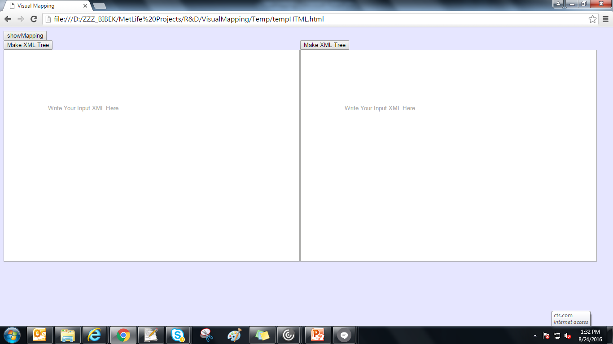
How to use it ?
Step 1:
Open the html file in Google Chrome. Below would be the initial screen.

Slide 7
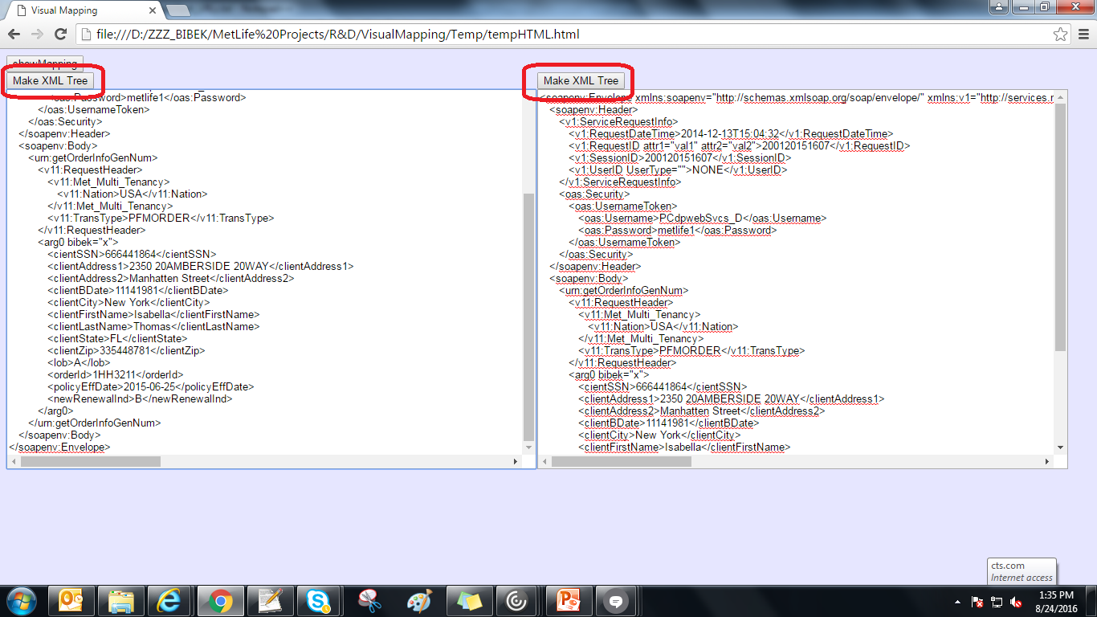
How to use it ?
Step 2:
Copy the source and target sample XMLs in the respective text area and click on “Make XML Tree” button (shown below).

Slide 8
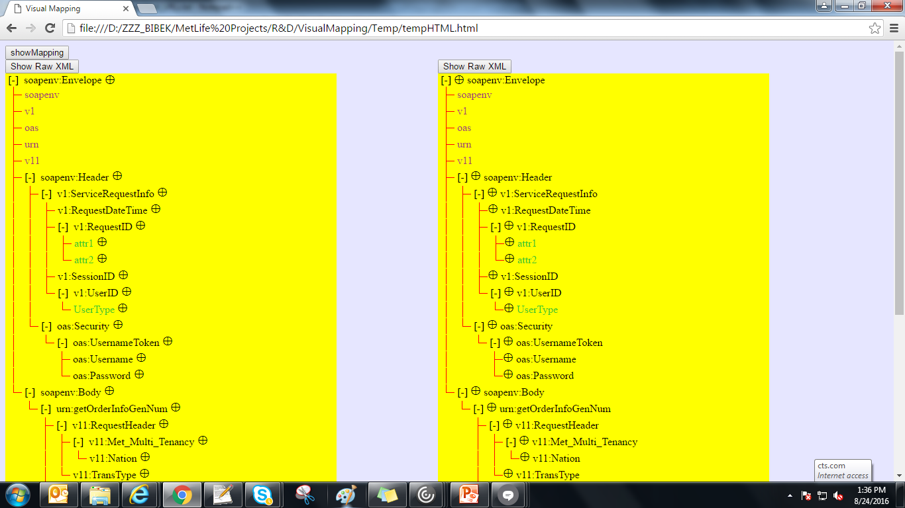
How to use it ?
Step 3:
Once the raw XML is transformed into XML tree, it would look like this. Each parent node can be collapsed and expanded here.

Slide 9
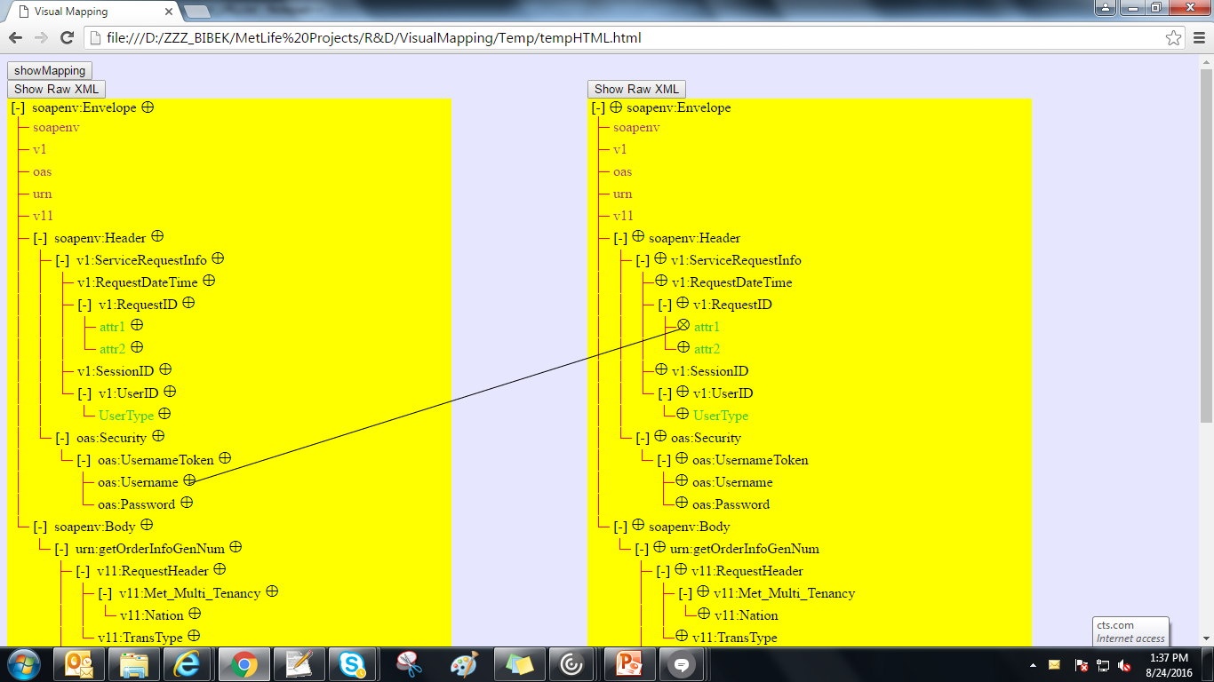
How to use it ?
Step 4:
Now once the XML tree is created, just click on the circled plus symbol of source element and drag the mouse to the target element and release the mouse button. One mapping line would be created. This line can be removed by double clicking on the line.

Slide 10
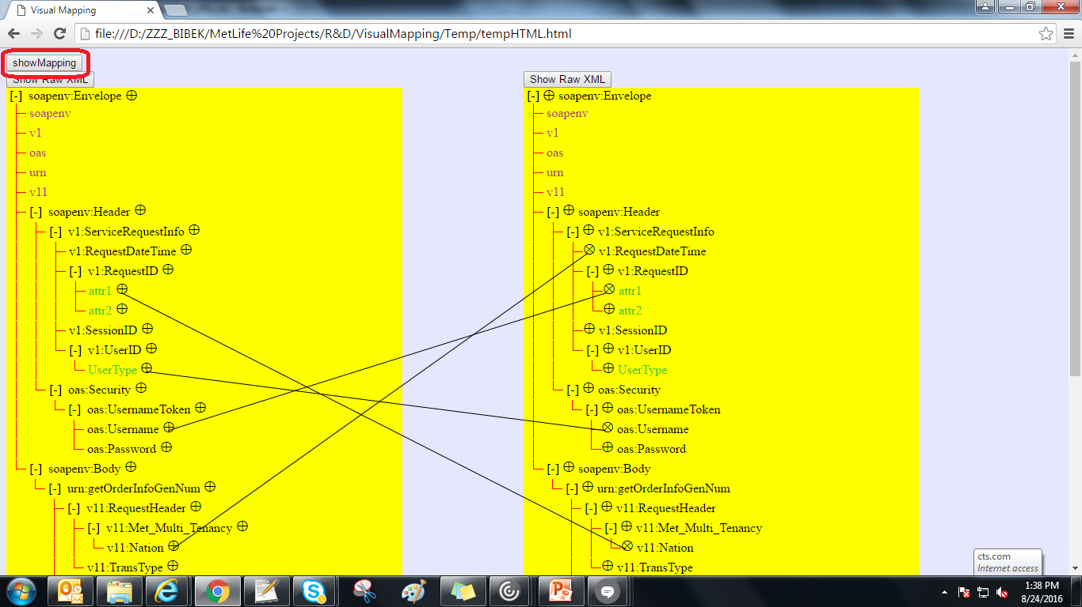
How to use it ?
Step 5:
Create as many mappings as you want like this. Once you are done with the mapping, click on the “Show Mapping” button (marked in below screenshot).

Slide 11
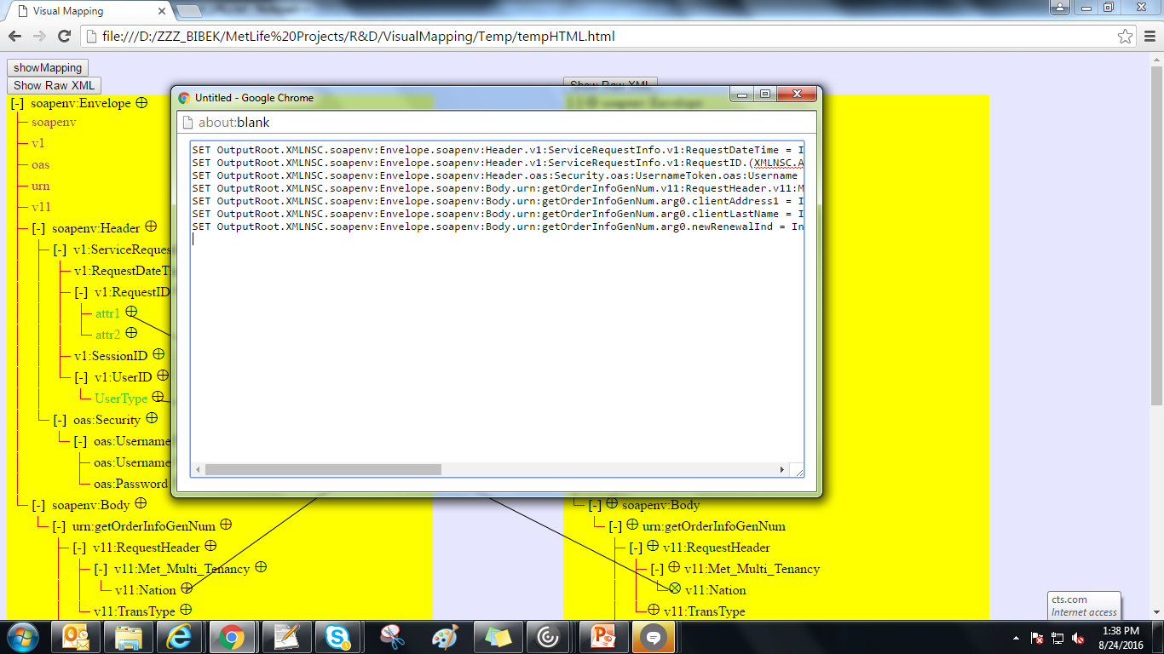
How to use it ?
Step 6:
After clicking on the “Show Mapping” button, one new window will open having the ESQL representation of the mapping. This mapping code can be copied to other file then.

Slide 12
How can I make it better ??

Slide 13
Scope of Enhancement
1. Construct XSLT
Currently the tool creates only ESQL as per the mapping.
In future, it can also create XSLT as per the mapping.
2. Function Implementation
Currently it only supports only 1 to 1 and 1 to many simple mapping.
Later it can be enhanced to implement functions like loop, condition checking, concatenation etc.
3. Cross browser support
Currently it is supported in only Google Chrome.
It can be enhanced to be used by other browsers.
4. File Browsing
Currently the input & output XMLs are being taken through text boxes.
Later the tool can be enhanced, so that these can be selected by browsing file location.
5. Use XSDs
Currently the source & target are only XMLs.
Later the tool can be enhanced, so that it can use XSDs for source & target.

Slide 14



